Slide 1
AlzheTect: Bio-Marker Analysis For Early Alzheimer’s Classification
Raidel Hernandez
C.S. Masters Graduation Project
Florida State University

Slide 2
AlzheTect Overview
Introduction
Data Analyzed
Data Transformations
Implementations
Results
Conclusion

Slide 3
What is Alzheimer’s?
Most Common Cause of Dementia (70%)
Affects memory, thinking, social ability
Neurodegenerative progressive disease
Worsens over time
Individuals Affected:
7% of individuals above 65
20% of individuals above 80
Notes:
Dementia: A set of conditions that affect memory, thinking, and social ability

Slide 4
AlzheTect’s Goal
Identify important biomarkers indicating Alzheimer’s
Classify individuals based on the stage of the disease
Cognitively Normal (CN)
Mild Cognitive Impairment (MCI)
Alzheimer’s Disease (AD)
MCI-to-AD
Predict when an MCI individuals will convert to AD

Slide 5
AlzheTect Overview
Introduction
Data Analyzed
Data Transformations
Implementations
Results
Conclusion

Slide 6
Obtained Data Files
Data was obtained by the Alzheimer’s Disease Neuroimaging Initiative (ADNI) studies:.
ADNI-1 (2004)
ADNI-GO (2009)
ADNI-2 (2011)
D1 (Training Data Set)
D2 (Validating Data Set)
Notes:
Come back to and fix/add stuff

Slide 7
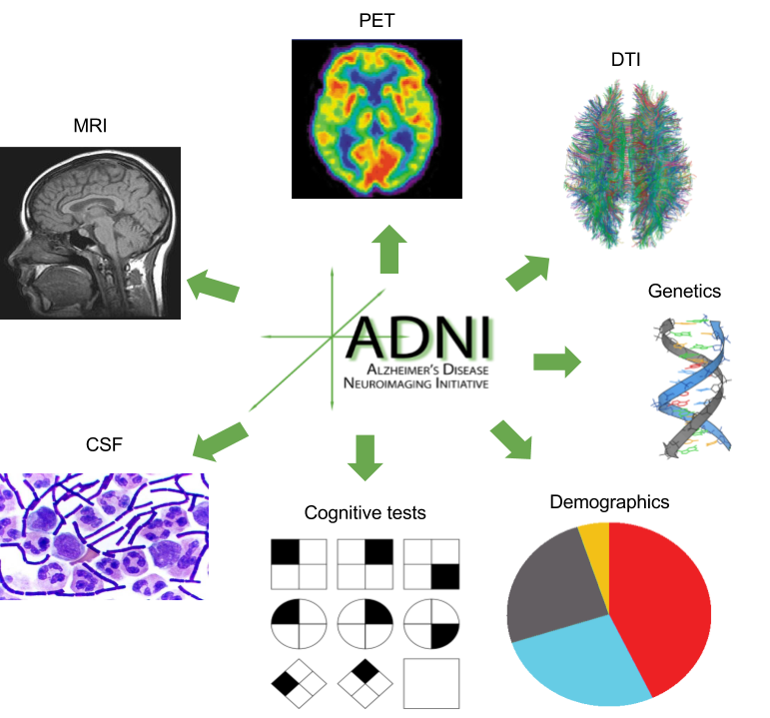
Bio-Marker Categories
Measures of Amyloid-Beta proteins
PET, CSF (Cerebrospinal fluid)
Measures of Damage to nerve cells
MRI, FDG-PET scans
Neuropsychological Tests
Cognition, Language, Memory, etc.
Risk Factors
Age, Genetics (APOE4), Gender
Notes:
What is an fdg pet scan?
fig 1: amyloid proteins misfold and group together in clumps, forming plaque and blocking cell-to-cell signaling at synapses
fig 2:

Slide 8
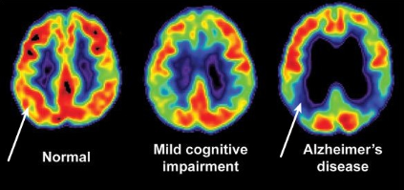
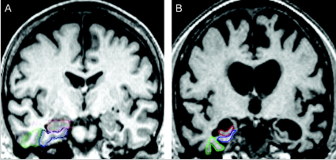
Bio-Marker Descriptions
PET
Measures neuron cell metabolism (FDG)
Levels of Amyloid-Beta misfolding (plaque)
MRI
Volume of Gray Matter
Consists of nerve cells
Volume of White Matter
Fibers connecting brain cells
Fig. 1: Cell metabolism in parietal region
Fig. 2: R-Hippocampus,
B-Entorhinal Cortex, G-Perirhinal Cortex
Notes:
What is an fdg pet scan?
amyloid proteins misfold and group together in clumps, forming plaque and blocking cell-to-cell signaling at synapses
fig 1: cell metabolism decreases during AD progression,
MRI: Atrophy by loss of volume in regions of interest (fig 2)

Slide 9
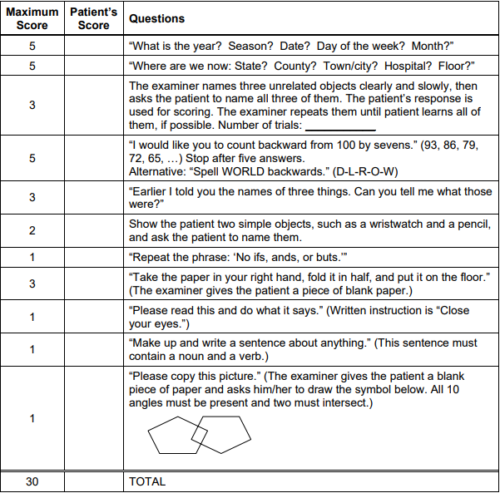
Bio-Marker Description
Cognitive Tests
Mini Mental State Exam (MMSE)
ADAS11, ADAS13
Risk Factors
Age (>65)
AD risk doubles every 5 years
Genetics (APOE4)
AD risk is 10% to 30% greater
Fig. 1: Example MMSE
Notes:
MMSE scores:
24-30 normal
18-23: MCI
0-17: SCI (severe cognitive impairment)
APOE4 individuals have 10 to 30 times higher risk of developing AD

Slide 10
AlzheTect Overview
Introduction
Data Analyzed
Data Transformations
Implementations
Results
Conclusion

Slide 11
Extracted Classes
Using DataFrames (Pandas Data Analysis Library)
Parse ADNI train/test data sets (CSV)
Entries in Training Dataset:
# of measurements: 12,741
# of unique individuals: 1,577
Features in Training Dataset:
1,907 (per entry)

Slide 12
Extracted Data
Diagnosis Classification
Provided by ADNI for each individual
Classifications Used: CN, MCI, AD, MCI-to-AD
Months-to-AD (Time) Classification
Initial AD diagnosis date - initial MCI diagnosis date (in months)
4 classes were extracted (based on quartiles)
0 : <12 months
1: 12 < X ≤ 24 mos
2: 24 < X ≤ 36 mos
3: >36 mos
Notes:
Individuals for CN were strictly CN and so on for AD and MCI
MCI-to-AD are strictly individuals who were at some point classified as MCI and converted to AD later
Months to AD

Slide 13
Extracted Classes
AD Stage Classifications
Classification | # of individuals
CN | 423
MCI | 483
AD | 332
MCI-to-AD | 339
Months-to-AD Conversion Classifications
Classification | # of individuals
<12 mos | 76
12 < X ≤ 24 mos | 110
24 < X ≤ 36 mos | 64
>36 mos | 89
Notes:
Talk about how the times were extracted for each classification:
Month when

Slide 14
Transformations Performed
Filter DataFrame for a Subset of Features
23 Bio-Markers
59 features (known indicators of AD)
Binarize Patient Gender
0 - Female
1 - Male
Notes:
Reduced the number of features to avoid overfitting

Slide 15
Transformations Performed
Normalize Data using an Imputer
Complete missing/NaN values
Replace missing values with the mean
Scaling the Data (Normalization)
Mean removal
Variance scaling
Notes:
Reduced the number of features to avoid overfitting
http://scikit-learn.org/stable/modules/preprocessing.html#preprocessing-scaler

Slide 16
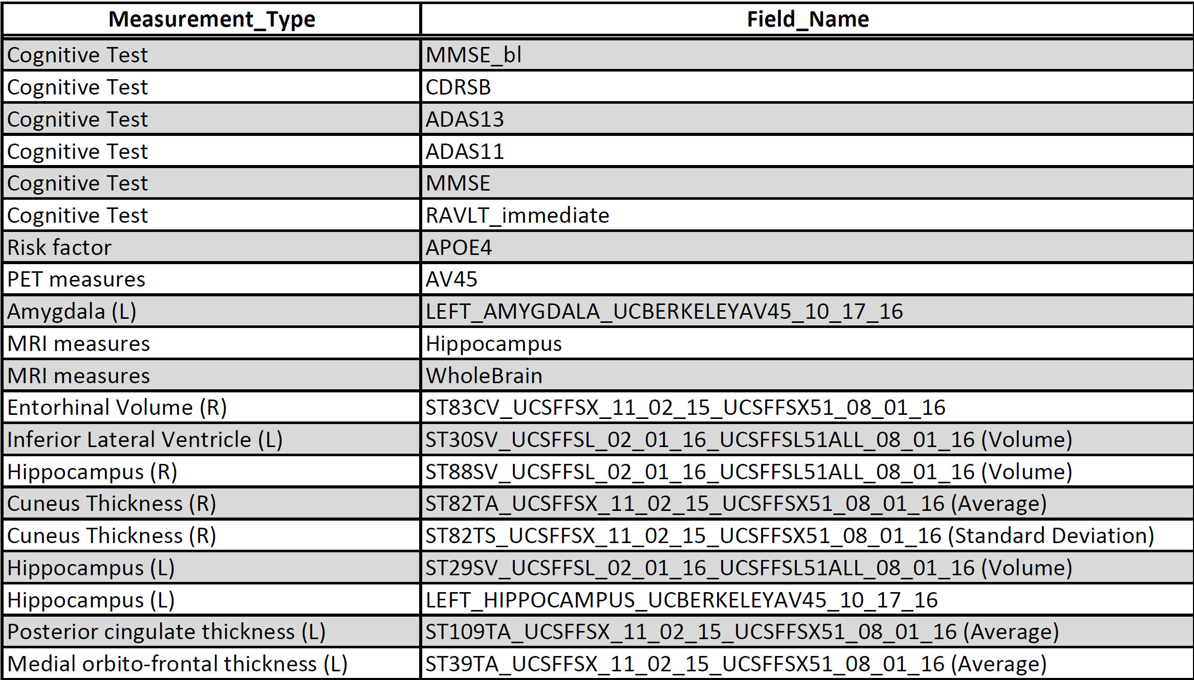
Feature Selection
Random Forest Classifier
Ensemble of Decision Trees (weak learners)
500 trees
20 max features when considering best split
Gini impurity measures split quality
Cross validation determined the features of importance
Notes:
Gini impurity - The impurity of each split and the final score when splitting at a certain feature
Entropy - Find the tree with the least number of splits to reduce computational complexity (possible). At each step, each branching, you want to decrease the entropy, so this quantity is computed before the cut and after the cut. If it decreases, the split is validated and we can proceed to the next step, otherwise, we must try to split with another feature or stop this branch.
Parallel execution
review the cross validation method used

Slide 17
Diagnosis Classification Data Sets
Total individuals in data set: 1,577
Data was shuffled and split as follows:
Training - 1,261 (80%)
Validating - 316 (20%)
Classification | Training Size | Validating Size
CN | 327 | 96
MCI | 395 | 88
AD | 270 | 62
MCI-to-AD | 269 | 70

Slide 18
Months-to-AD Data Sets
Total individuals in data set: 339
Data was split as follows:
Training - 271 (80%)
Validating - 68 (20%)
Classification | Training Size | Validating Size
<12 mos | 59 | 17
12 < X ≤ 24 mos | 92 | 18
24 < X ≤ 36 mos | 50 | 14
>36 mos | 70 | 19

Slide 19
AlzheTect Overview
Introduction
Data Analyzed
Data Transformations
Implementations
Results
Conclusion

Slide 20
Classifiers Utilized
K-Nearest Neighbors (KNN)
Lazy Learner
Support Vector Classifier (SVC)
Eager Learner
Deep Neural Network (DNN)
Eager Learner
Notes:
Edit this slide more
2 different types of learners in classification:
Lazy learner- “Training Stage” is minimal, Validating stage takes more time
Eager learner - Eager learners construct a classification model based on the given training data before receiving data for classification. It must be able to commit to a single hypothesis that covers the entire instance space. Take a long time for train and less time to predict

Slide 21
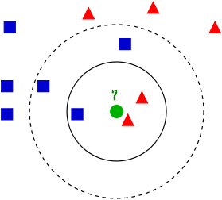
KNN Classifier
Classifies based on feature similarity
How related to K number of neighbors is the data point
Finding Optimal K
10-fold cross-validation
Use K with minimum misclassification error
Notes:
Add more info about knn here
Lazy classifier - “Training Stage” is minimal, Validating stage takes more time
check with 6, 7, and 8 neighbors in code
k-fold Cross validation - test each classifier created (in for loop) with different values, by splitting the data into k folds (use k-1 for training, 1 for validating)

Slide 22
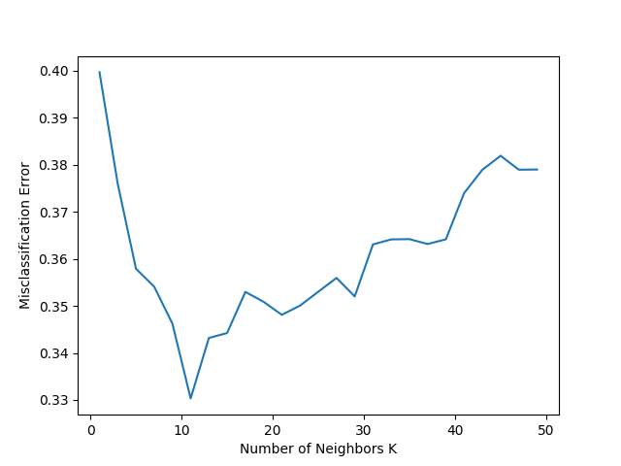
KNN Parameters (Diagnosis)
Using K=11
Provided the lowest misclassification error
Distance Metric
Euclidean Distance for nearest neighbors
All neighbors are equally weighed
Notes:
Lazy classifier - “Training Stage” is minimal, Validating stage takes more time
check with 6, 7, and 8 neighbors in code
https://kevinzakka.github.io/2016/07/13/k-nearest-neighbor/#more-on-k
get knn graph using trained model if possible
Curse of dimensionality - when dimensionality is high the data becomes sparse and distance becomes harder to generalize
euclidean distance can be applied to any size dimensional data

Slide 23

SVM Classifier
Defined by a separating line or hyperplane
Depending on the number of dimensions (classes)
Decision function - distance of X to the separating hyperplane
Kernel
Radial Basis Function (RBF)
Maps input vectors into higher dimensional feature space
Notes:
RBF transforms the vectors into higher Dimensions
||x-x’||^2 - Squared euclidean distance between two feature vectors
exp (exponential)

Slide 24
SVC Boundary Parameters
Parameter C (Penalty parameter)
Larger Value → Small Margin
Smaller Value → Large Margin (smooth boundary)
Gamma (Kernel Coefficient)
Influence of a Single Training Example
High Value
Close values affect the decision boundary
Low Value
Far points affect the decision boundary (smooth boundary)
Notes:
larger value - errors are penalized more
Support Vector Machine we always look for 2 things:
Setting a larger margin
lowering misclassification rate(how much a model misqualifies a data)
SVM looks for a larger margin (lower misclassification in training does not mean lower misclassification in testing)
Gamma: how much influence a single training example has
Larger Gamma → the closer other examples must be to be affected

Slide 25
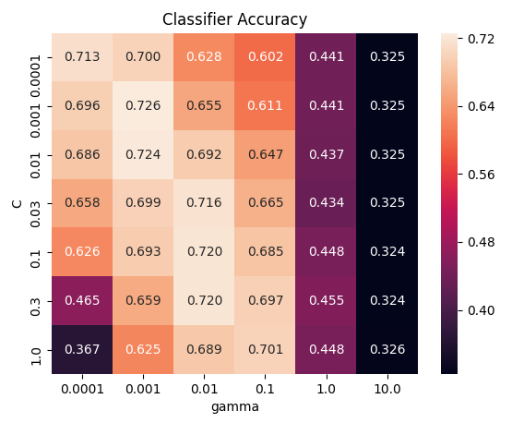
SVC Parameter Tuning (Diagnosis)
Using a Stratified Shuffle Split
Split data into 10 splits
9:1 [Training:Validating]
Tested different values for gamma and C
Gamma: 0.001
Parameter C: 0.001
C = 1/0.001
Notes:
larger value - errors are penalized more
Support Vector Machine we always look for 2 things:
Setting a larger margin
lowering misclassification rate(how much a model misqualifies a data)
Gamma: how much influence a single training example has
Larger Gamma → the closer other examples must be to be affected

Slide 26
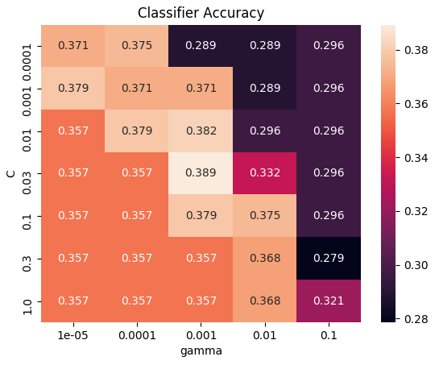
SVC Parameter Tuning (Time)
Using a Stratified Shuffle Split
Gamma: 0.001
Parameter C: 0.03
C = 1/0.03
Notes:
larger value - errors are penalized more
Support Vector Machine we always look for 2 things:
Setting a larger margin
lowering misclassification rate(how much a model misqualifies a data)
Gamma: how much influence a single training example has
Larger Gamma → the closer other examples must be to be affected

Slide 27
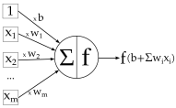
DNN Classifier
Interconnected Network of Neurons
Neurons sum the values of previous neurons + connection weight
Activation functions used:
relu : input layer and hidden layers
softmax : output layer, provides probability prediction
Notes:
Add svm, and knn for months to ad classification code
The purpose of an activation function in a Deep Learning context (i.e. multiple layers) is to ensure that the representation in the input space is mapped to a different space in the output.
The model contains 11 layers:
1 input (relu activator) layer + 9 hidden layers (mix of
relu and tanh activators) + 1 output layer (softmax)
Parameter optimization: adam optimizer used

Slide 28
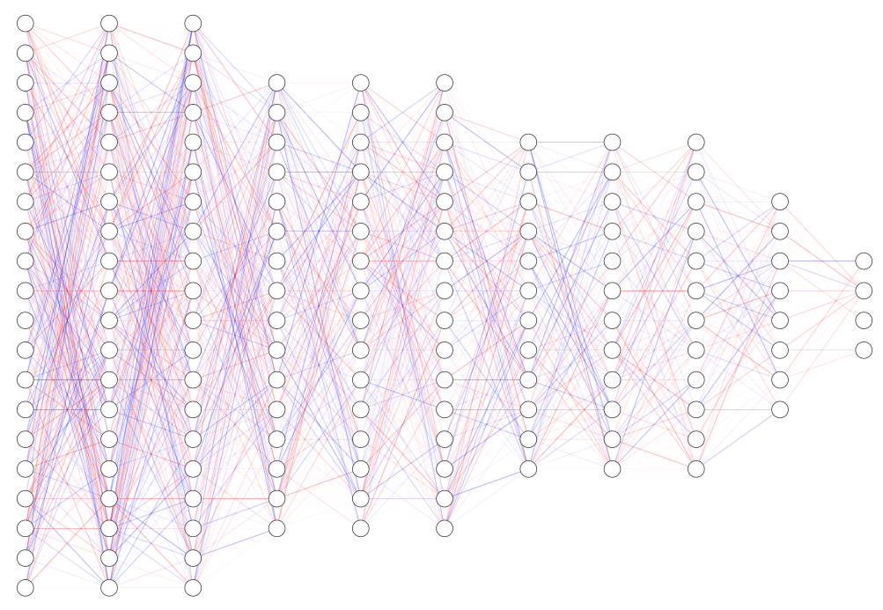
DNN Classifier (Diagnosis)
Parameter Optimization
Adam Optimizer
128
64
32
8
4
Notes:
Add svm, and knn for months to ad classification code
The model contains 11 layers:
1 input (relu activator) layer + 9 hidden layers (mix of
relu and tanh activators) + 1 output layer (softmax)
Parameter optimization: adam optimizer used (to control the learning rate)
uses moving averages of the parameters

Slide 29
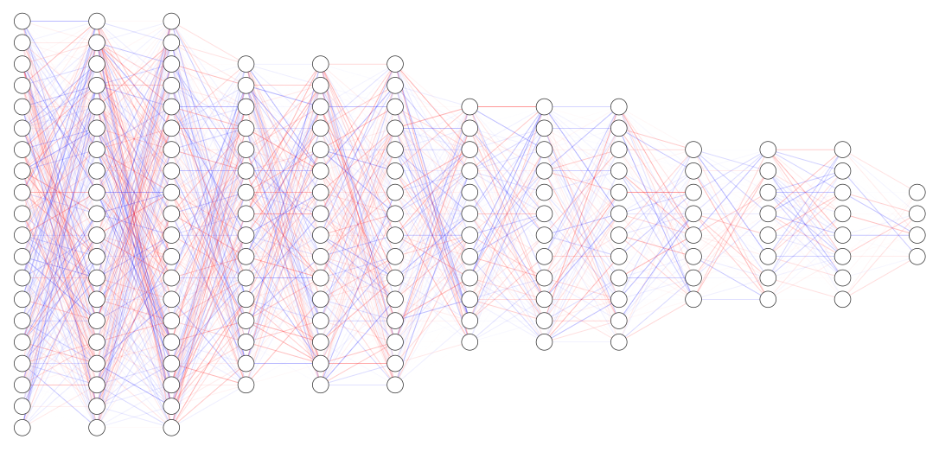
DNN Classifier (Time)
Parameter Optimization
Adam Optimizer
20
16
12
8
4
Notes:
Add svm, and knn for months to ad classification code
The model contains 11 layers:
1 input (relu activator) layer + 9 hidden layers (mix of
relu and tanh activators) + 1 output layer (softmax)
Parameter optimization: adam optimizer used

Slide 30
AlzheTect Overview
Introduction
Data Analyzed
Data Transformations
Implementations
Results
Conclusion

Slide 31
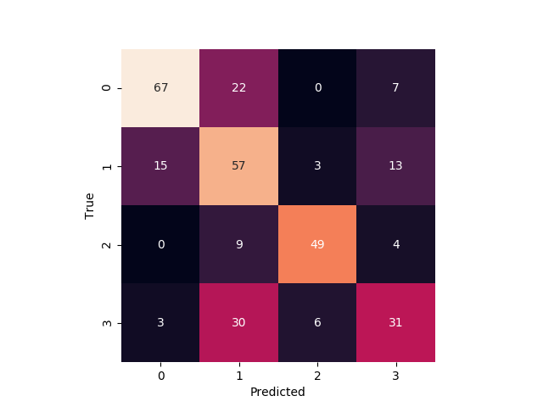
KNN (Diagnosis)
Stage | Correct | Total | % Correct
CN | 67 | 96 | 70%
MCI | 57 | 88 | 65%
AD | 49 | 62 | 79%
MCI-to-AD | 31 | 70 | 44%
Accuracy:
65%
Notes:
add results in tables on web page

Slide 32
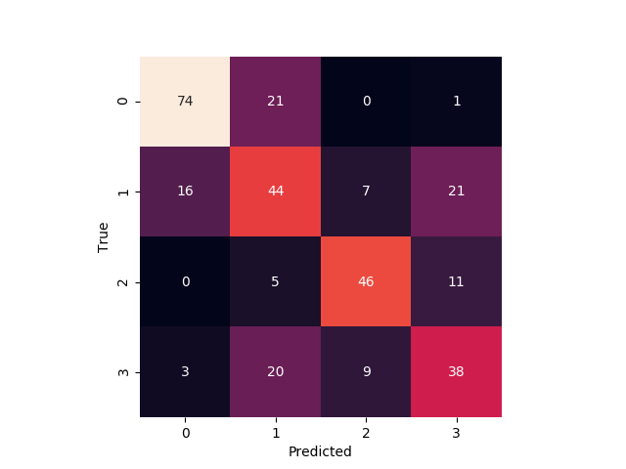
DNN (Diagnosis)
Stage | Correct | Total | % Correct
CN | 74 | 96 | 77%
MCI | 44 | 88 | 50%
AD | 46 | 62 | 68%
MCI-to-AD | 38 | 70 | 54%
Accuracy:
68%

Slide 33
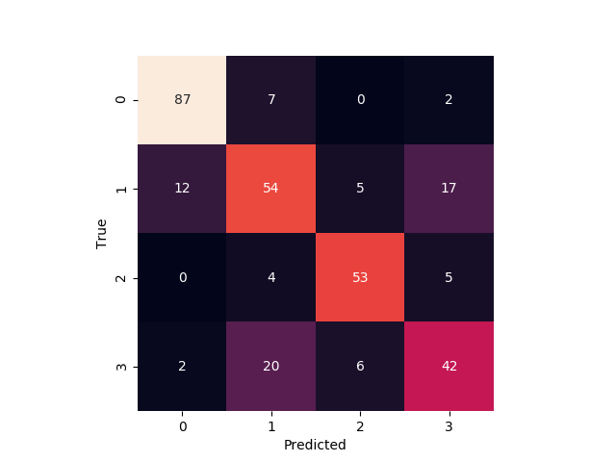
SVC (Diagnosis)
Stage | Correct | Total | % Correct
CN | 87 | 96 | 91%
MCI | 54 | 88 | 61%
AD | 53 | 62 | 85%
MCI-to-AD | 42 | 70 | 60%
Accuracy:
75%

Slide 34
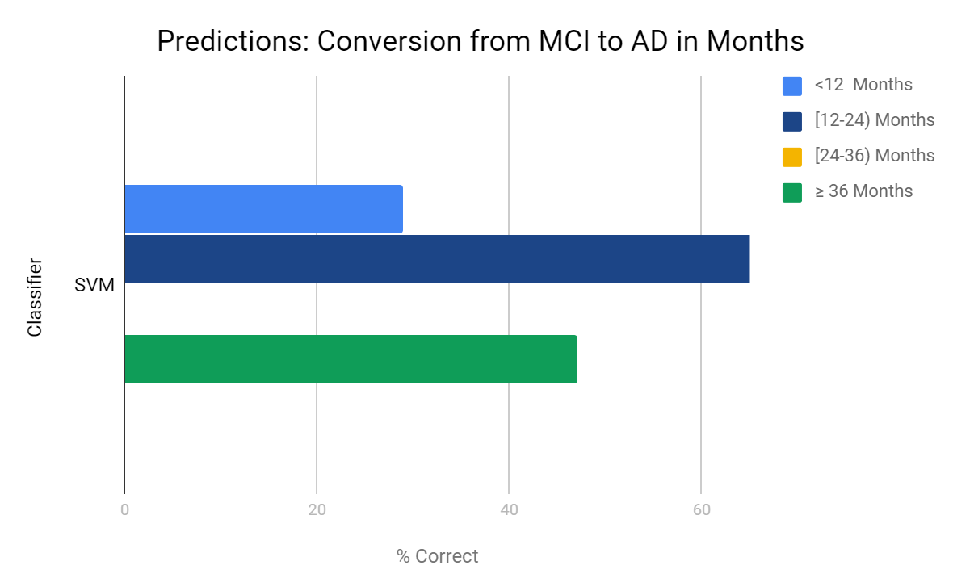
SVC (Time)
Accuracy:
36%

Slide 35
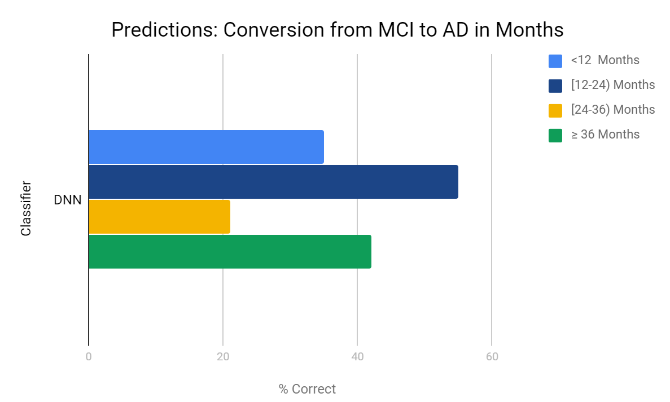
DNN (Time)
Accuracy:
38%

Slide 36
AlzheTect Overview
Introduction
Data Analyzed
Data Transformations
Implementations
Results
Conclusion

Slide 37
Conclusion
Eager learners outperform lazy learners in AD classification
SVM outperforms DNN and KNN in AD classification
DNN outperforms SVM in MCI-to-AD conversion time classification
More data sets are required to properly classify MCI-to-AD progression
ADNI-3

Slide 38
AlzheTect: Bio-Marker Analysis For Early Alzheimer’s Classification
Raidel Hernandez
C.S. Masters Graduation Project
Florida State University

